Slide 1
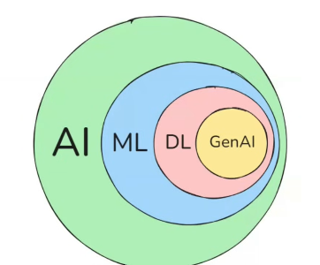

π
Guardrails
Langgraph
Notes:
Content: https://www.linkedin.com/pulse/chunking-strategies-ai-data-kash-kashyap-0lghe/

Slide 2
Human In The Loop
Guardrails are structured, rule‑based controls that embedded within agentic AI systems to monitor inputs, limit behavior, and validate outputs. They serve as runtime checkpoints; filtering, sanitizing, or overriding when necessary to keep the content safe, aligned, and contextually appropriate.

Slide 3
Why Guardrails Matter in LLM Systems 🚧
Some use-cases are mentioned below.
Prevent harmful or biased content. The LLMs might generate offensive or unsafe responses unintentionally. In such cases, output Guardrails help in detecting content violations like toxicity, fake claims, and restricted topics and automatically refuse them.
Stop hallucinations (fake facts). LLMs tend to generate random text that looks real but is fake when they don’t have the appropriate knowledge to respond with. Guardrails help flag or block this kind of misinformation by checking the groundedness of the response.
Ensure legal and ethical compliance. Guardrails help to ensure responses align with the policies, industry regulations, or brand tone. e.g., filtering out the illegal or medical guidance that violates compliance requirements.
Reduce manipulation and jailbreak risks (e.g., prompt injection). Users may try jailbreak or injection prompts to override safety filters. Guardrails detect and block these attacks, keeping the system secure. If the user intent diverges from the domain of interest, the system redirects or refuses such requests.

Slide 4
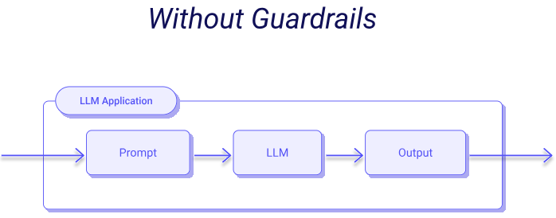

Slide 5
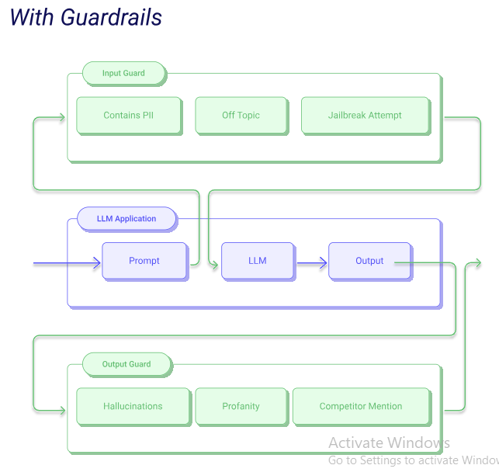

Slide 9
Command Object

